Slide 1
Moving Object Trajectory Processing based on Multi-Laser Sensing
*Yipu Zhao, H. Zhao, J. Sha, and H. Zha
Department of EECS, Peking University
Notes:
Hello, everyone. My name is Zhao Yipu. And I am from Peking University, China. Today, I wanna give a brief presentation on our work titled “Moving Object Trajectory Processing based on Multi-Laser Sensing”

Slide 2
Outline
Background
System overview
Our approach
Experimental results
Conclusion
Notes:
This is today’s outline. First, a brief background introduction. Then an overview of the multi-laser sensing system is given. After that, I will talk about our approach of trajectory processing and show some experimental results. At last our future work will be discussed.

Slide 3
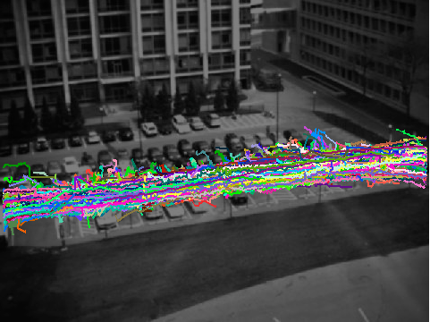
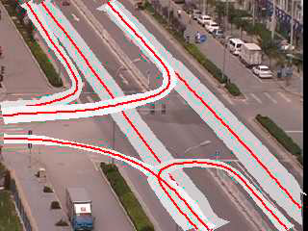
Background
For applications like:
Trajectory analysis
Scene modeling
Abnormal detection
X. Wang, CVPR 2008
X. Dan, ICPR 2004
X. Dan, ICPR 2004
Trajectories of good quality are required!
Notes:
In these days, there are great needs in applications like:
trajectory analysis, scene modeling and abnormal detection,
so that to provide higher knowledge to intelligent transportation systems.
In these applications, trajectories of good quality are required.

Slide 4
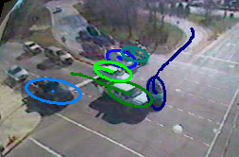
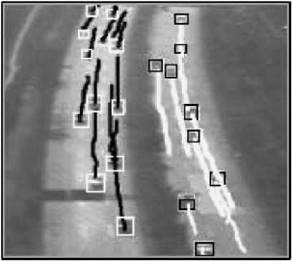
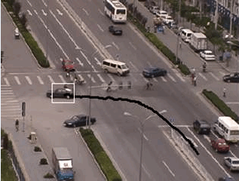
Background
The trajectories are provided by moving object tracking systems
Z. Kim, CVPR 2008
R. Rad, PR Letters 2005
X. Dan, ICPR 2004
Notes:
Currently, the trajectories are provided by moving object tracking systems, which are mostly vision-based.

Slide 5
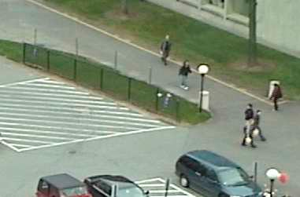
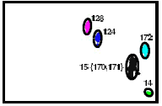
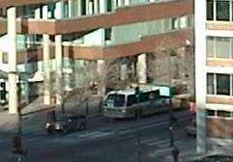
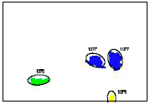
Background
Some erroneous moving object detection and tracking reduce the quality of trajectories:
Merge
Split
Notes:
However, for the tracking systems, split/merge events happen frequently and reduce trajectory quality greatly.
Here is an example of merge event, three people are merged as one; Then it is a split example, a bus is split as two parts.

Slide 6
Background
Therefore, a trajectory processing method that improves the quality of trajectories is necessary
  Handle mistakes in tracking results
  Provide better input data for following applications
Moving Object Detection/Tracking
Trajectory Processing
  Trajectory Analysis / Scene Modeling
Notes:
Therefore, a trajectory processing method that improves the quality of tracking results is necessary.
Such a method can handle mistakes in tracking results, and provide better input data for following applications.
It is the goal of our research.

Slide 7
Outline
Background
System overview
  System setting
  Collected data
Our approach
Experimental results
Conclusion
Notes:
Now comes an overview of the multi-laser sensing system, which is used to generating tracking results in traffic scenes.

Slide 8
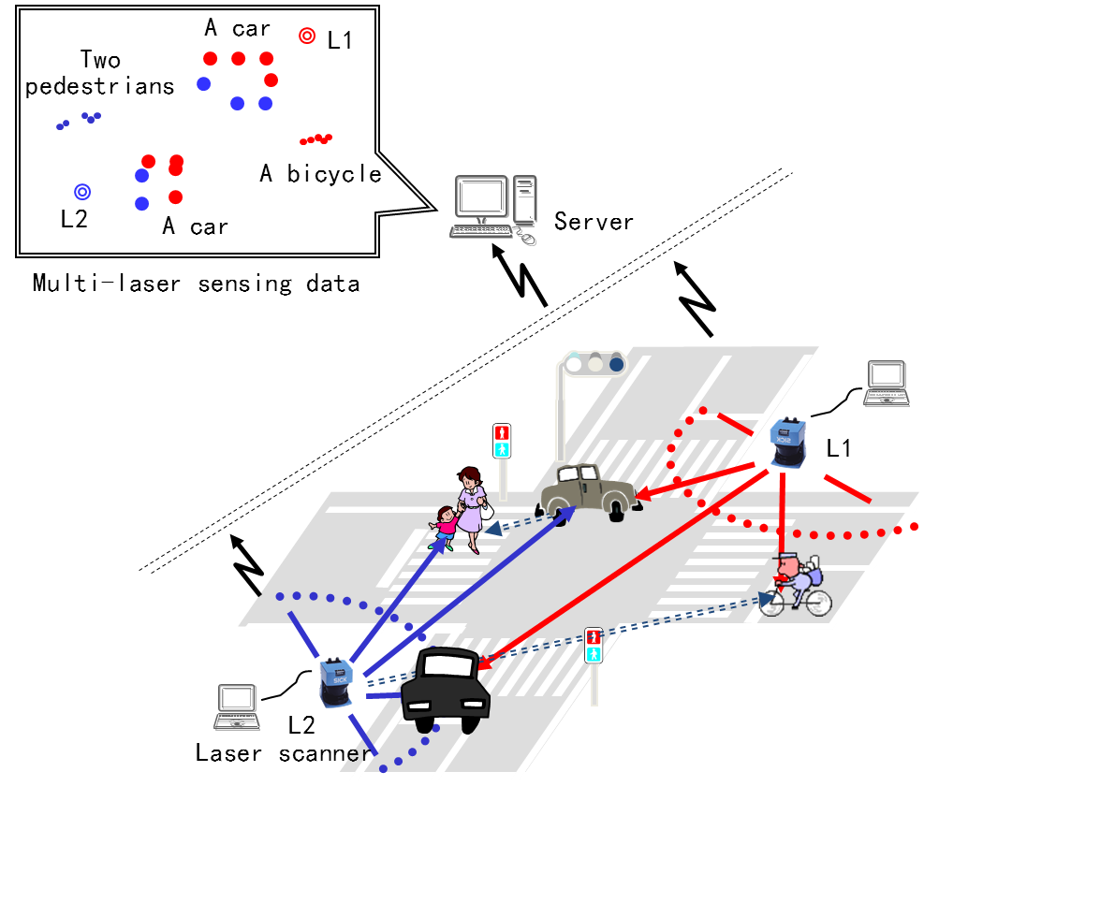
System Setting
Horizontal profiling of the intersection.
Generating integrated frame from all laser scanners.
Notes:
In our multi-laser sensing system, laser scanners are set on roadside profiling the intersection from different locations.
By assembling data from all laser scanners, an integrated frame is generated, which provides a complete horizontal contour view of moving objects at the moment.
An example of integrated frame is displayed here.

Slide 9
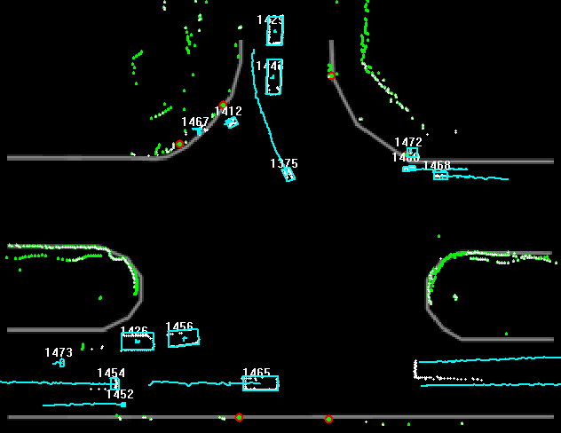
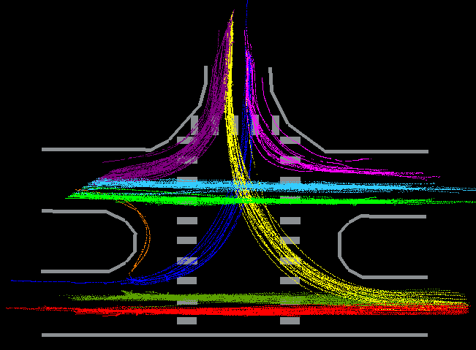
Trajectory Data Collection
Trajectory
Server PC
Moving object detection/
tracking
Data Integration
Calibration, Synchronization
Network
…
Clustering
Clustering
Background
Model 1
Background
Subtraction
Background
Model N
Background
Subtraction
Scan Data
Scan Data
Client PC
Laser Scanner 1
Laser Scanner N
Notes:
This is a flow of major processing modules.
By applying moving object detection and tracking on the integrated laser data, we obtain moving object trajectories, such as pedestrians, bicycles and vehicles that passing the scene.
Here is a video of obtained trajectories.
Also a set of trajectory data is visualized in the image, where color denotes for traffic patterns

Slide 10
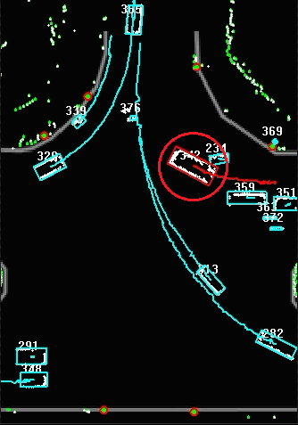
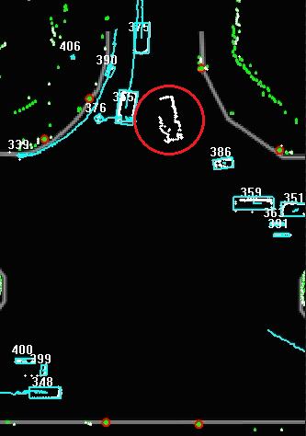
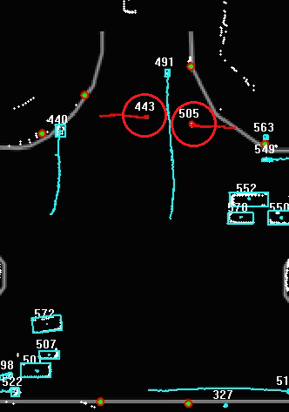
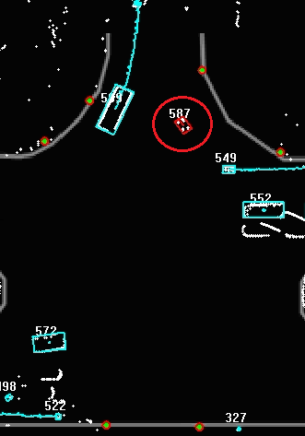
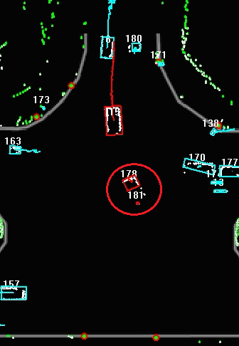
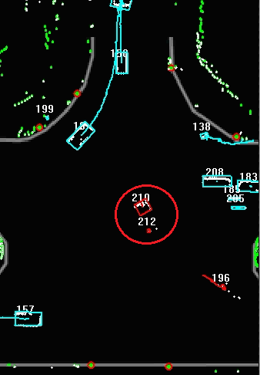
Mistakes in Trajectory Data
1. Broken trajectory
2. Group trajectory
3. Fragment trajectory
Broken trajectory
Group trajectory
Fragment trajectory
Notes:
Similar to other moving object tracking systems, there are mistakes in our obtained trajectory data.
The first mistake is broken trajectory, e.g. interruption when tracking the car.
The second one is group trajectory, two pedestrians' trajectories are merged together.
The third one is fragment trajectory, a car is split into parts in the tracking results.
Therefore, the main purpose of trajectory processing is to select and correct these mistakes.

Slide 11
Outline
Background
System overview
Our approach
  Trajectory association
  Trajectory labeling
  Trajectory parameter optimization
Experimental results
Conclusion
Trajectory Association
Trajectory Labeling
Trajectory Parameter Optimization
Notes:
A three-step trajectory processing approach will be introduced in the following slides.

Slide 12
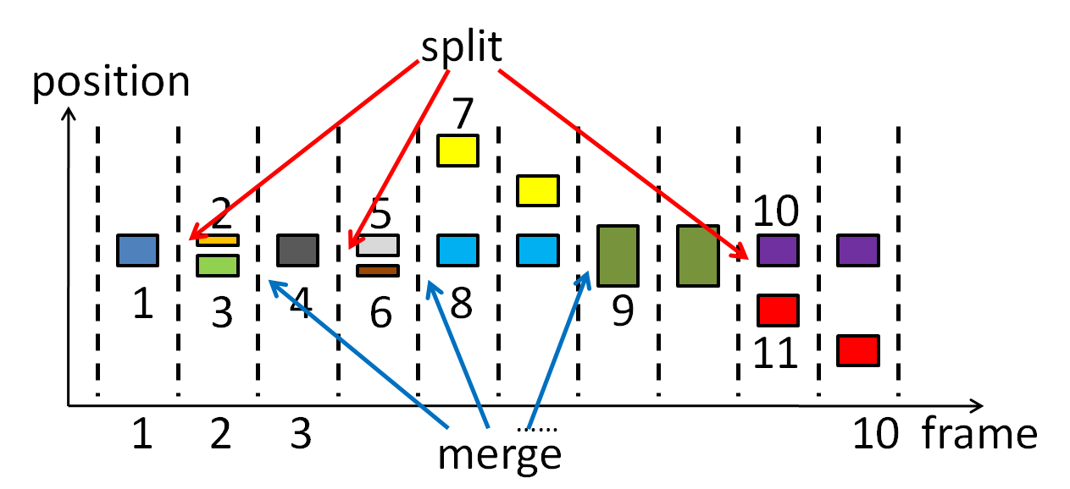
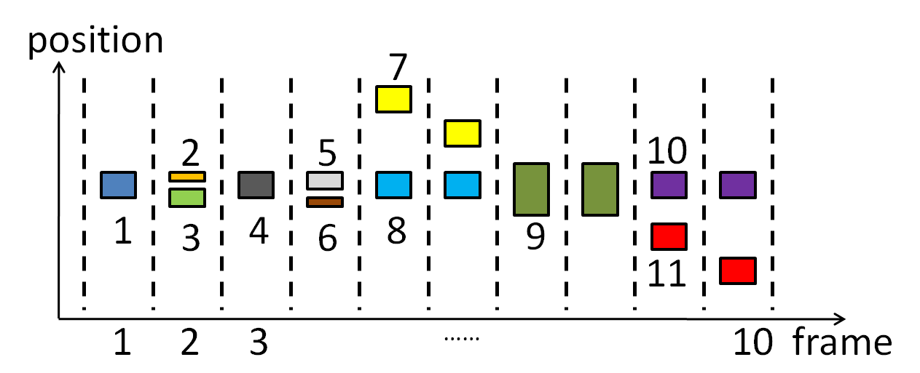
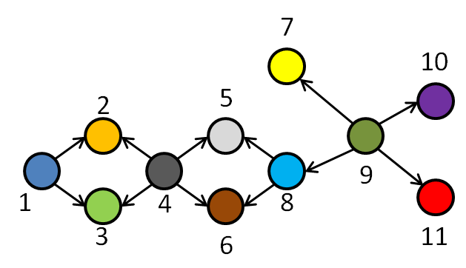
  1. Trajectory Association
Trajectories of the same object are associated in a graph manner
Step1. generating initial interaction graph
  Input: Output:
Initial interaction graph
Split, merge and broken events detected
Notes:
The first step is trajectory association.
In this step, trajectories of the same object are associated together in a graph manner.
Given a set of trajectories, we first detect split, merge and broken events in it.
Then a initial interaction graph is built, where each node denotes for a trajectory, and an edge represents the detected event between the two nodes.
For example, trajectory 1 splits into 2 and 3; then 2 and 3 merge as trajectory 4.
Corresponding, in the interaction graph, two edges are linked from node 1 to node 2 and 3, also two edges are linked from node 4 to the 2 and 3.

Slide 13
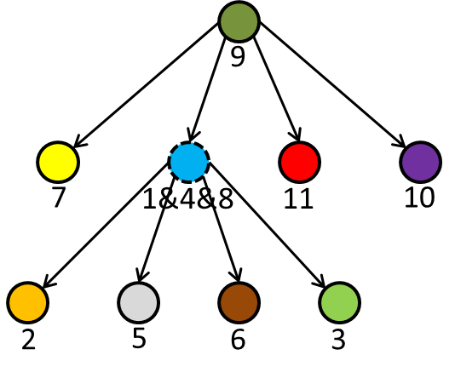
  1. Trajectory Association
Step2. merging nodes that corresponding to the same target
  Input: Output:
In the end, a final interaction graph is generated
Initial interaction graph
Interaction graph
Notes:
After that, nodes that corresponding to the same target are detected and merged, and the graph is simplified.
For example, tracking targets of node 1, 4 and 8 are the same, so these nodes are merged together, and a final interaction graph is generated.
Notice that to emphasize the hierarchy, the graph is displayed in a tree-view.

Slide 14
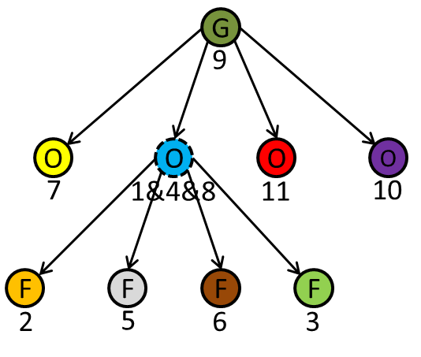
2. Trajectory Labeling
Possible trajectory: group, object and fragment.
Label definition
  Group Object Fragment
By graph inference, all nodes are labeled in a global optimized way.
  Input: Output:
G
O
F
Notes:
Previously we generate an interaction graph to associate trajectories.
For each node of interaction graph, it can be considered as an object, a group of merged objects or a fragment of split object.
Given an interaction graph, we want to label each node as group, object or fragment and a graph inference method is introduced .

Slide 15
2. Trajectory Labeling
Four relationships
  There are four types of relationships for one parent node and several child nodes in the interaction graph
G
G
G
G
O
O
(1) Group-Group
(2) Group-Object
O
F
F
F
F
F
(3) Object-Fragment
(4) Fragment-Fragment
Notes:
The graph inference relies on a hypothesis, that there are only four types of parent-child relationships in the interaction graph.
There may be a group trajectory merged by several smaller group ones.
Also there might be a group trajectory merged by several object ones.
Moreover, an object trajectory may split into some fragment ones.
Last, a fragment trajectory can split into several smaller fragment ones.

Slide 16
2. Trajectory Labeling
Two conditions
  Condition1. Shape Coherency
  Condition2. Motion Coherency
Fragments
Fragments
The object’s contour
Motion vector
Trajectory labeling based on the
four relationships and two conditions!
Notes:
To determine the parent-child relationships in the graph as one of the four defined types, two conditions are introduced.
The first one is shape coherency.
And the second one is motion coherency.
Based on the four relationships and the two conditions, all trajectories are labeled as fragment, object or group.

Slide 17
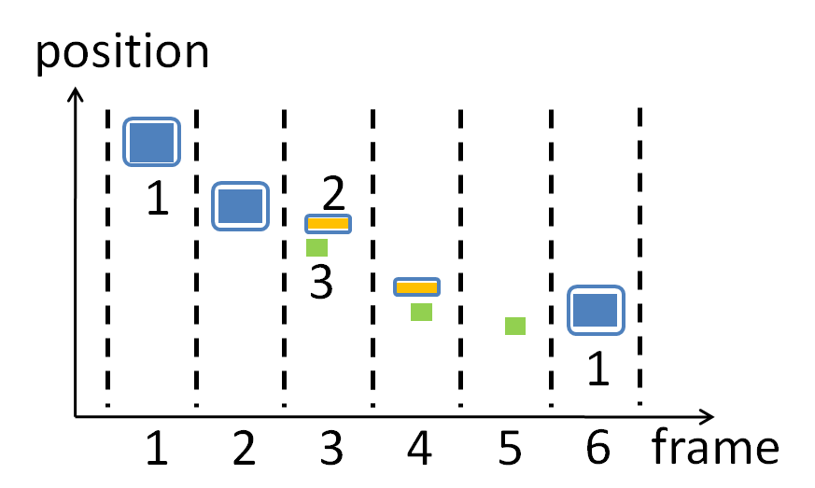
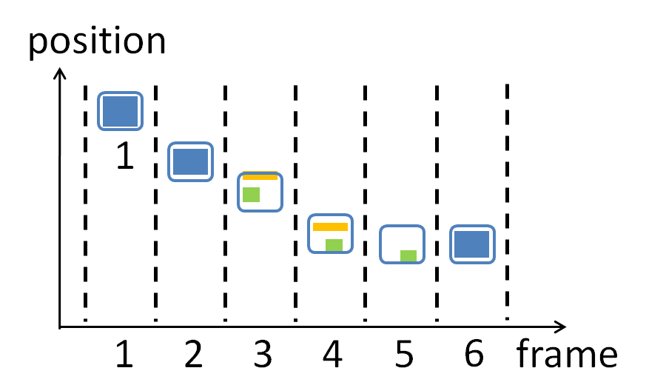
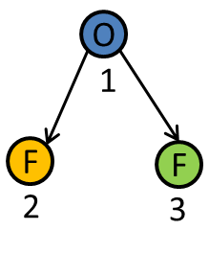
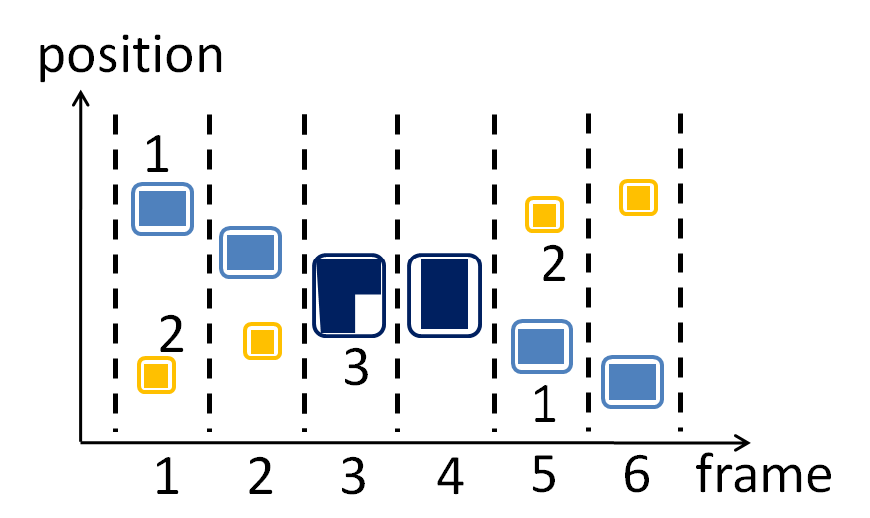
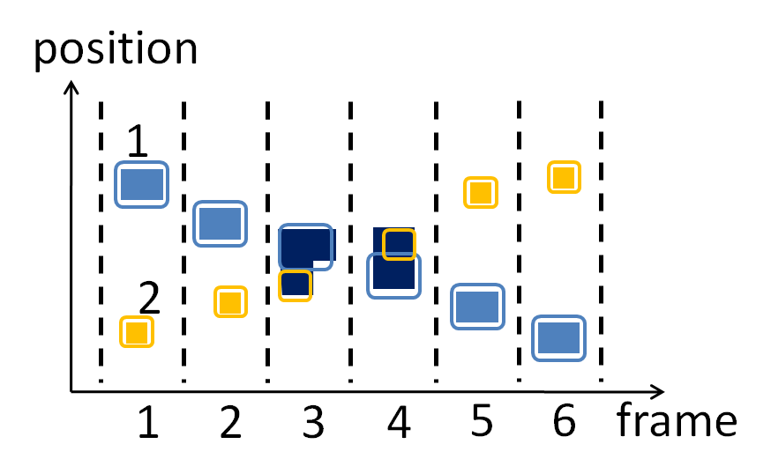
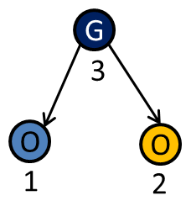
  3. Trajectory Parameter Optimization
Generate an optimized estimation to trajectory parameters using EM Algorithm
  Input Output
Notes:
After trajectory labeling, fragment and group trajectories are labeled from tracking results.
A step of trajectory parameter optimization is required to correct these mistakes.
EM algorithm is applied here.
Given a set of trajectories that are associated and labeled, we correct erroneous ones and generate the final output of our approach.

Slide 18
Outline
Background
System overview
Our approach
Experimental results
Conclusion
Notes:
Then there are some experimental results

Slide 19
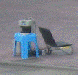
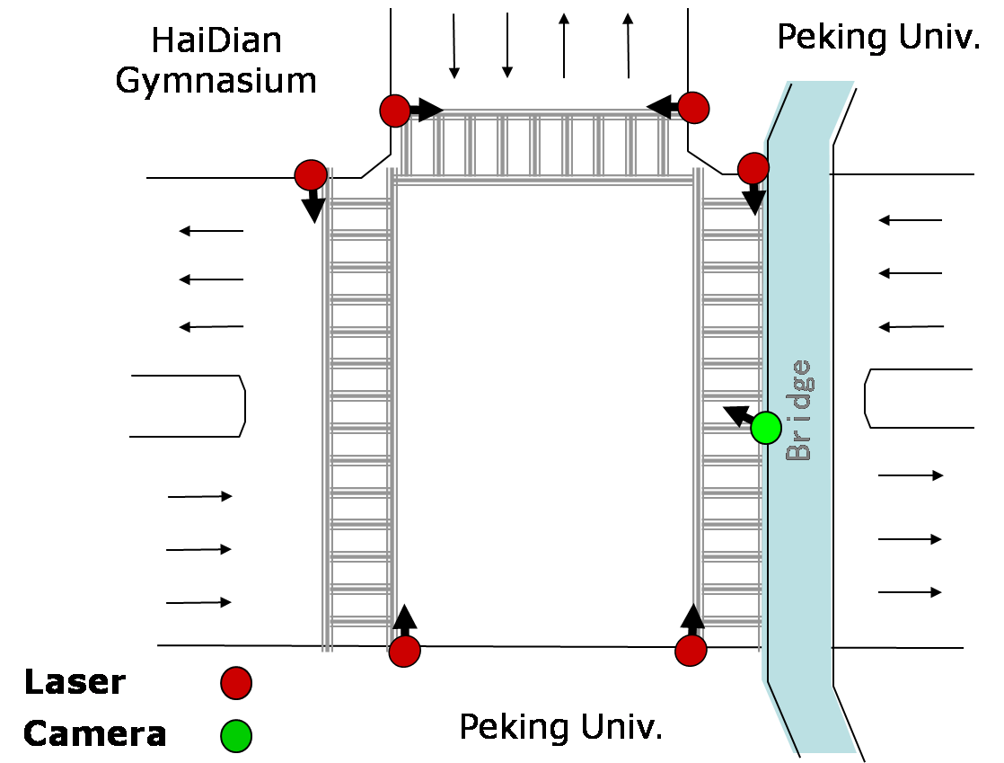
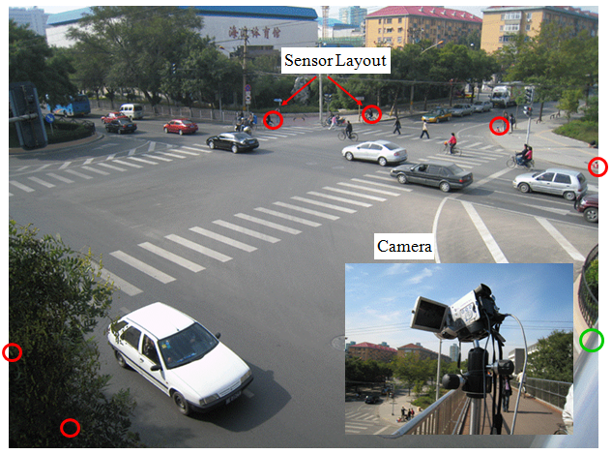
Experimental Results — Statistics
40 cm
Period | 07:00~07:20, a.m.
Frames | 44785
Trajectories before processing | 6281
Trajectories after processing | 4195
Group trajectories | 310
Fragment trajectories | 1033
Broken trajectories | 1826
Notes:
To prove the effectiveness of our approach, an experiment is conducted in an intersection at Beijing, China.
The laser sensors are set 40 centimeters above the ground, profiling the scene horizontally.
Through a 20 minutes collection, 6281 trajectories are collected.
By applying our approach on these trajectories, 310 group ones, 1033 fragment ones and 1826 broke ones are selected and corrected.

Slide 20
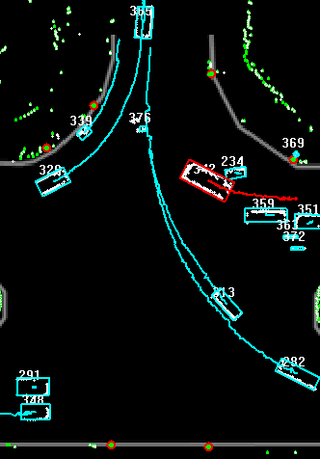
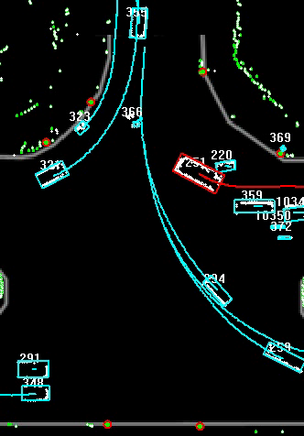
Experimental Results — Broken Trajectories
Before processing
After processing
Notes:
There are two comparing videos about broken trajectories.
In the original tracking results, the red trajectory of a car break two times.
After processing, the red colored car is tracked stably.

Slide 21
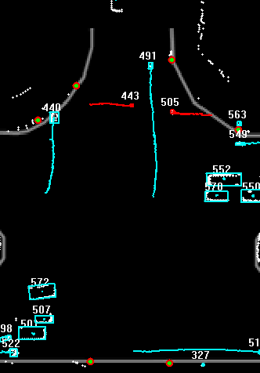
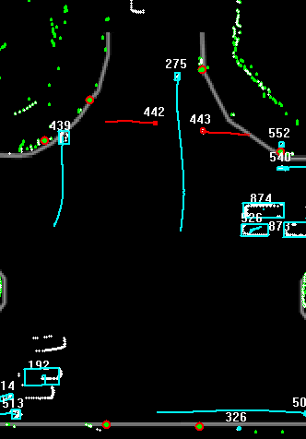
Experimental Results — Group Trajectories
Before processing
After processing
Notes:
Then two comparing videos about group trajectories.
Before processing, two red colored pedestrians are merged as a group for a while.
Then the group split, and the two ones are tracked as new trajectories.
After processing, the trajectories of the two pedestrians are steady through the entire merge and split process.

Slide 22
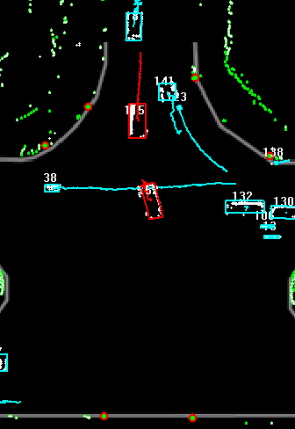
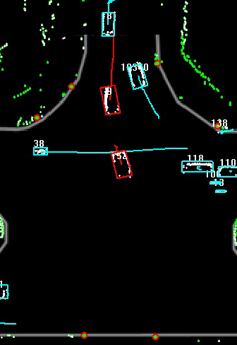
Experimental Results — Fragment Trajectories
Before processing
After processing
Notes:
At last, we give two comparing videos about fragment trajectories.
In the original tracking results, two red colored vehicles are split into several fragment trajectories.
After processing, the two vehicles are tracked stable even in situations that lack of laser data.

Slide 23
Outline
Background
System overview
Our approach
Experimental results
Conclusion

Slide 24
Conclusion
A trajectory processing algorithm is developed
  The effectiveness of our approach is demonstrated in real intersection environment
  As a general method, the algorithm can be applied to other systems as well
Future work
  More experiments are required
  The performance of trajectory parameter optimization needs improvement
Notes:
In the future, More experiments are required as we only tested our method on one traffic scene.
Also the performance of trajectory parameter optimization needs improvement.

Slide 25
Thank you

