Slide 1
Computing Object-based Saliency in Urban Scenes Using Laser Sensing
*Yipu Zhao, M. He, H. Zhao, F. Davoine, and H. Zha
Department of EECS, Peking University
Sino-French Lab, CNRS & LIAMA
Notes:
Hello, everyone. My name is Yipu Zhao. And I am from Peking University, China. Today, I wanna give a brief presentation on our work titled “Computing Object-based Saliency in Urban Scenes Using Laser Sensing”

Slide 2
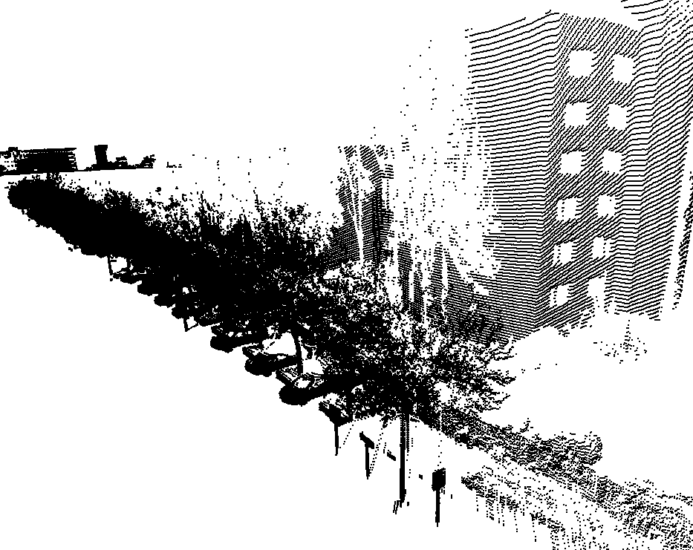
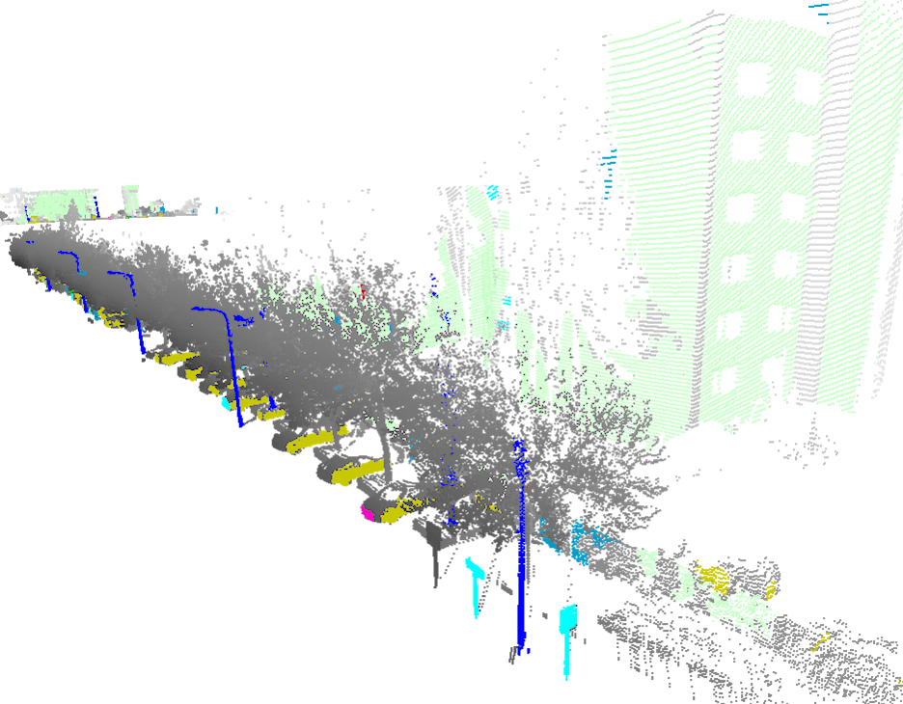
Motivation
Object discovery from mobile laser scanning.
Notes:
Many existing researches have demonstrated that a large environment, such as urban, can be mapped using laser sensing techniques.
This research is motivated in discovering the objects of interest such as buildings, traffic lights, traffic signs and cars from a large amount of laser points, which are acquired by a mobile sensing platform.

Slide 3
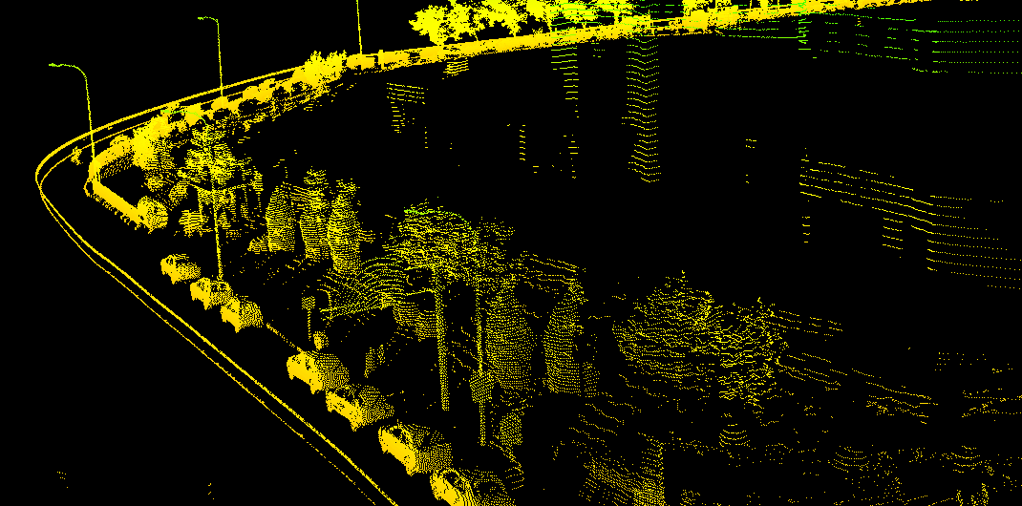
Background
Different applications may concern different objects.
Put more focus on the objects of interest.
Notes:
There are many difficulties in such task.
First of all, the data amount is huge!
However, in many applications, the objects of interest are different.
For example, the applications for generating an urban map focus on the static objects, while the ITS applications may also concern cars and pedestrians.
Therefore for such applications, it is not necessary to universally process on the whole laser points, while we may put more focus on the objects of interest.

Slide 4
This Research
Objective: Compute the object-based saliency of laser points
Computing Object-based Saliency
Laser Points
Object Detection
Step1
Step2
Step3
Geometric Feature Extraction
Object Candidate Generation
Object-based Saliency Computing
Notes:
This lead to the objective of this paper: compute the object-based saliency of laser points.
The result will help in object detection in the subsequent procedures.
A three step approach is developed, where, step 1:…, step 2:…, step 3.
In the following, we briefly introduce our research platform, then explain the algorithms in each step.
The algorithms have been examined using large amounts of laser points that are collected through the experiments in Beijing. We show experimental results and give conclusions finally.

Slide 5
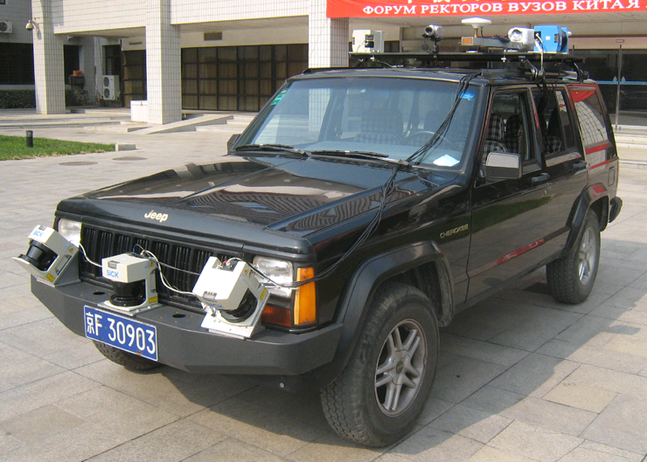
Experimental Platform
GPS
IMU
LMS
LMS
Notes:
稍停顿
This video shows how we acquire data. We only show the data acquired by the right scanner.
In this approach we use the form of range image to represent data.
5

Slide 6
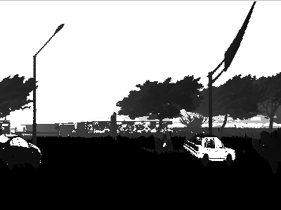
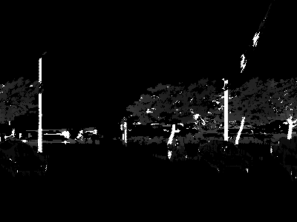
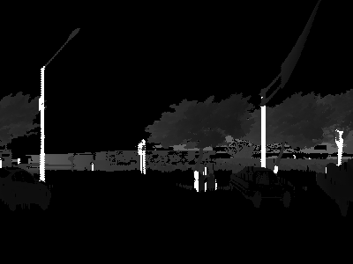
Step 1. Geometric Feature Extraction
Four types of geometric features
Vertical line Horizontal line
Vertical plane Horizontal plane
Range Image
Seed Selection
Region Growing
Geometric Features
Notes:
The 1st step of out approach is geometric feature extraction.
Here we define 4 types of geometric features: vertical line, horizontal line, vertical plane and horizontal plane.
To extract them, a 2-step approach is used:
Given a range image, first seed selection. seeds of different types of geometric features are selected based on a series of pixel-level features (e.g. normal & surface fitting variation).
Second, region growing. Starting from the seeds, all nearby pixels with similar pixel-level features are grown together.

Slide 7
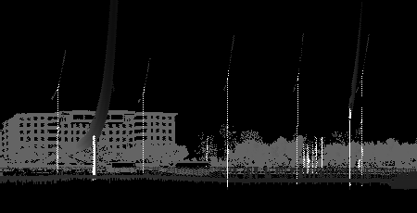
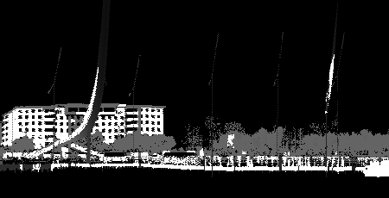
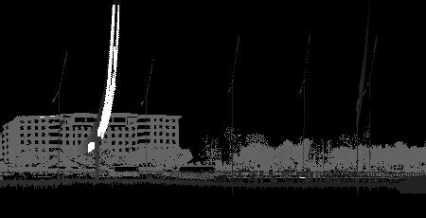
Step 1. Geometric Feature Extraction
Extraction results
Vertical Line
Horizontal Line
Vertical Plane
Horizontal Plane
Notes:
Here are some geometric feature extraction results. Pixels of the extracted geometry are highlighted.

Slide 8
Step 2. Object Candidate Generation
Objects $≈$ Combination of geometric features
Car $≈$ several surface planes
Road lamp $≈$ a long pole
Traffic sign $≈$ a board with a supporting stick
Finding combination of geometric features
Geometric Features
Voting Candidate Centers
Clustering Centers
Object Candidates
Notes:
After extracting GFs, here we consider objects as combination of them, e.g. car, road lamp, traffic sign.
So the task of generating object candidates turns to be finding certain combination of geometric features.
And a voting scheme is applied.
First, the candidate centers are voted for each geometric feature;
Then, the centers of the same object class are clustered, and the candidates are generated based on these clusters.

Slide 9
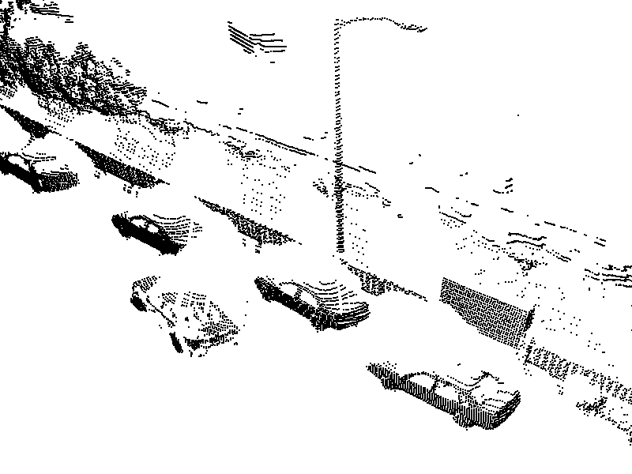
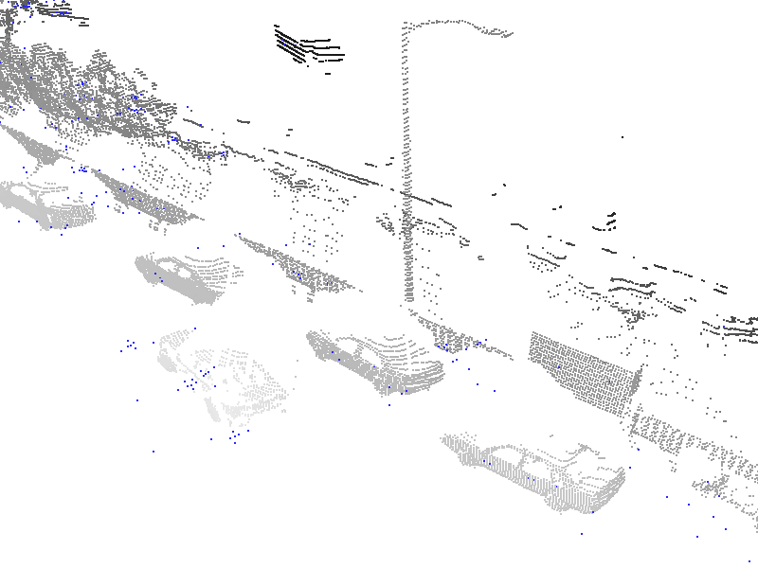
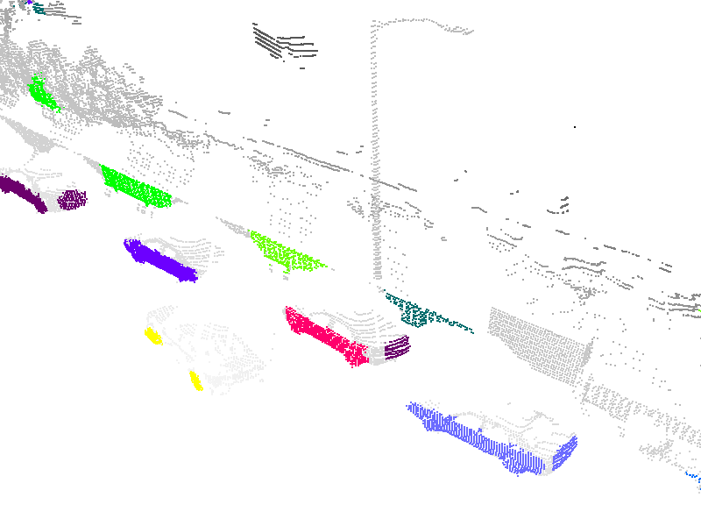
Step 2. Object Candidate Generation
Voting car candidate
Notes:
Here is an example of object candidate generation.
Vote all possible car centers, illustrated by blue dot
Some clusters
Candidate, notice some other objects are considered as car candidates as well.

Slide 10
Step 3. Object-based Saliency Computing
The object-based saliency depends on
Type & size of the related geometric features
Spatial relationship between geometric features
To contain these information
A graphical object representation is introduced
Object Candidates
Graph Generation
Graph Matching
Salient Objects
Notes:
The last step is to compute the Object-based Saliency for each candidate.
The object-based saliency depends on 2 kinds of information:
First, information of each related geometric feature, like type & size;
Second, spatial relationship between nearby geometric features, like paralleling or top and bottom;
To contain the two, a graphical object representation is introduced.
So we first generate a graph for each candidate, then match it with some examples.

Slide 11
3.1 Graph Generation
Graph definition:
Node: Type & size of geometric features
Edge: Spatial relationship of different geometric features
i
z
$$\vec{i′j′}$$
i
Object coordinate
$$\vec{j′i′}$$
$\vec{i′j′}$&$\vec{j′i′}$
j
j
y
x
Notes:
Let’s introduce the graphical object representation in detail.
Naturally, nodes are used to store type & size of geometric features,
while edges are coding the spatial relationship of geometric features.
Given the a traffic sign candidate, whose primary geometries are extracted previously.
We will fix an object coordinate for it so as to avoid shifting & rotational variant of graphical representation.
Then those extracted GFs are taken as the nodes of the graph, and the edge between them means that the two nodes have a inclined up and down relation in 3D space.

Slide 12
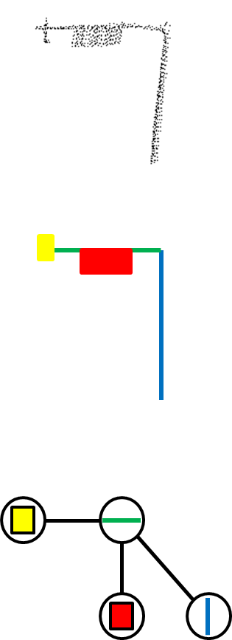
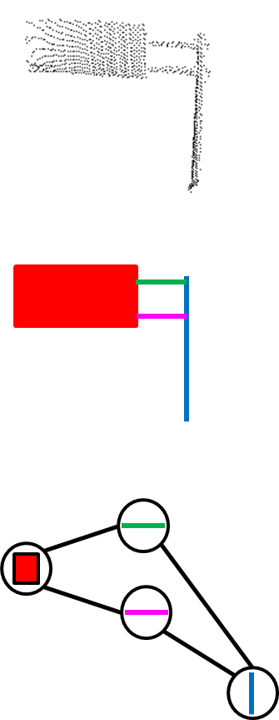
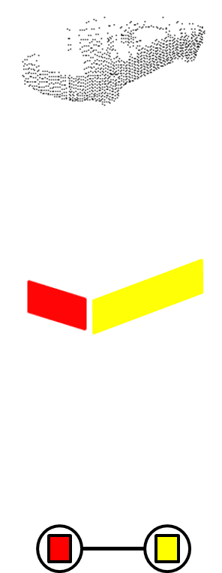
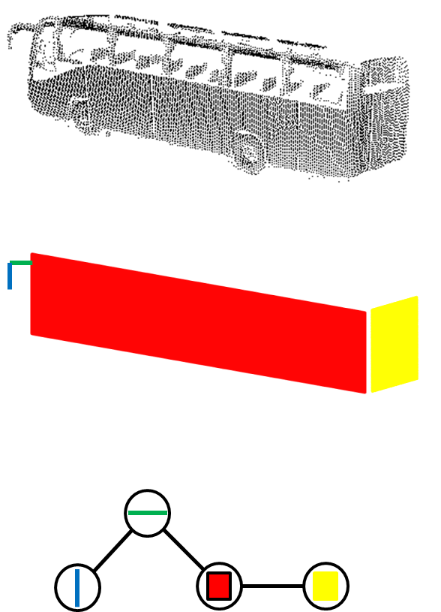
3.1 Graph Generation
Some model graphs of objects of interest
Car
Bus
Road lamp
Traffic light
Traffic sign
Notes:
In this way, we build model graphs of a variety of objects of interest.
First row the laser data;
Second row the extracted geometries;
And third row the graphical representations.

Slide 13
3.2 Graph Matching
Evaluate matching score between a previously trained model graph $\left.G_{m}=(N_{m},E_{m}\right)$ and a data graph $\left.G_{d}=(N_{d},E_{d}\right)$
Step 1. Inexact graph matching
Only concern edge attributes
Generate 2 sub-graphs $\left.G_{ms}=(N_{ms},E_{ms}\right)$ & $\left.G_{ds}=(N_{ds},E_{ds}\right)$
Step 2. Score evaluating
$D(G_{m},G_{d})= max(\sum_{k=0}^{\left.card(N_{ms}\right)}{S_{N_{ms}^{k}}},\sum_{k=0}^{\left.card(N_{ds}\right)}{S_{N_{ds}^{k}}})/{max}(\sum_{k=0}^{\left.card(N_{m}\right)}{S_{N_{m}^{k}}},\sum_{k=0}^{\left.card(N_{d}\right)}{S_{N_{d}^{k}}}$)
where $N^{k}$ denotes for the $k$th node in node set $N$,
and $S_{n}$ is the area of node $n$'s corresponding geometric feature
Notes:
After generating graphs of object candidates, we need to tell if they are salient objects or not.
So we gonna evaluate the matching score between the previously trained model graph and the data graph of a candidate.
The first step is inexact graph matching. Only the edge attributes of two input graphs are used here.
After generating two best-matching subgraphs, the score is evaluated using the formulation. The node attributes (e.g. area & type) are considered here.

Slide 14
Experiment
1. Highway scene (the 4th ring road, Beijing)
Collecting time cost: 35 minutes
Data volume: about 14,300,000 laser points
Sample: 26 model graphs for 8 object classes
Processing time: 18 minutes (on a 2.8GHz & 8G PC)
Notes:
We tested our approach on a dataset collected on highway, which is collected in 35 minutes.
To compute object-based saliency, 26 model graphs belonging to 8 kinds of objects of interest are generated first.
Then the processing time of our approach is 18 min.
A statistical result is presented below.

Slide 15
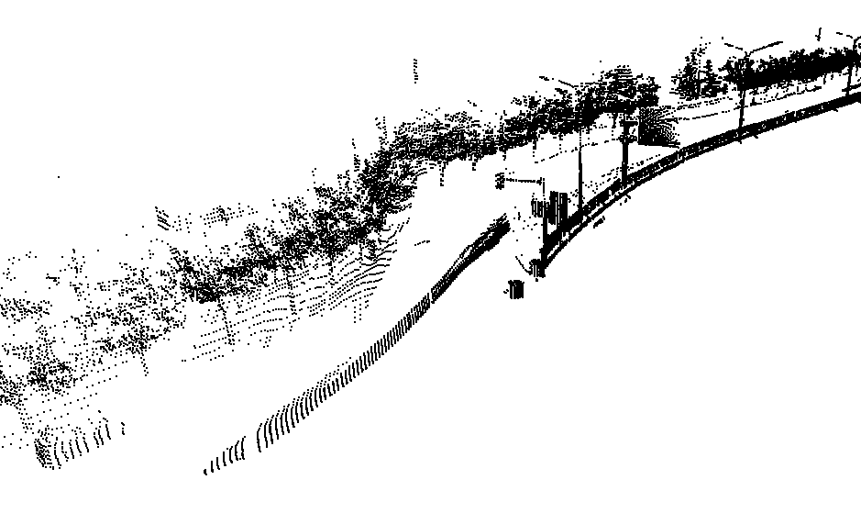
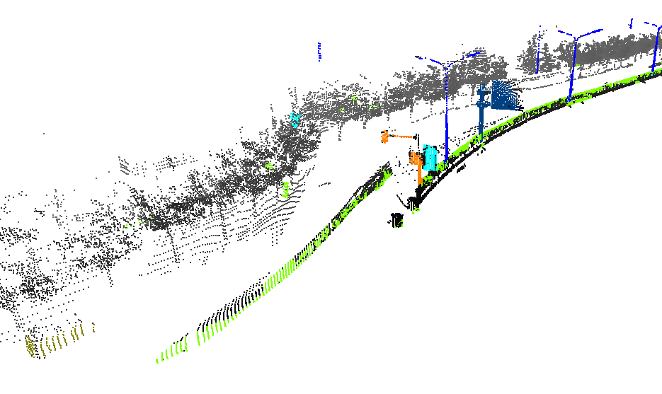
Result in Highway Scene
Car
Traffic sign
Road lamp
Signpost
Traffic light
Road belt
Notes:
Here’s a result.

Slide 16
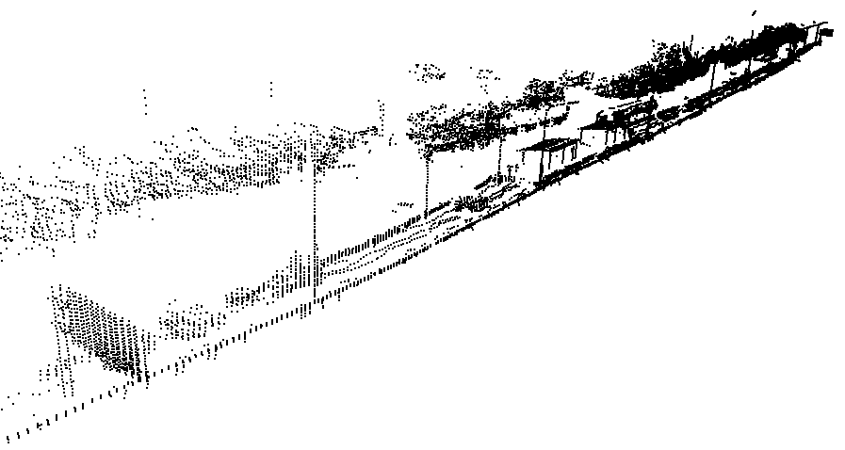
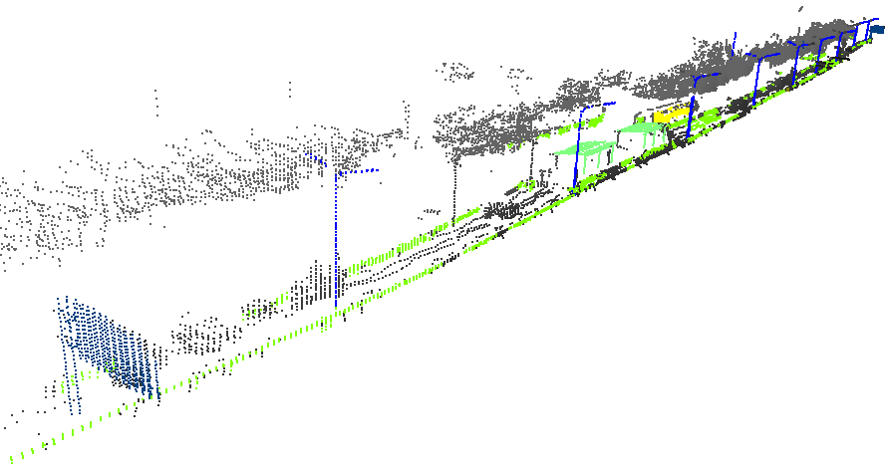
Result in Highway Scene
Bus
Traffic sign
Road lamp
Building
Traffic light
Road belt
Notes:
Another result.
Bus … Bus stop …
In fact, highway scene is not quite challenging.
Because it’s highly structured and relatively simple.

Slide 17
Experiment
2. Street scene (Street ShangDi, Beijing)
Collecting time cost: 30 minutes
Data volume: about 13,210,000 laser points
Sample: 38 model graphs for 11 object classes
Processing time: 20 minutes (on a 2.8GHz & 8G PC)
Notes:
So another test is done in street scene, which is more crowded and complex than highway.
This time we use 38 model graphs belonging to 11 classes of objects of interest.
The processing time is a bit longer, 20 min.
That’s because more candidates are generated and matched in this challenging environment.

Slide 18
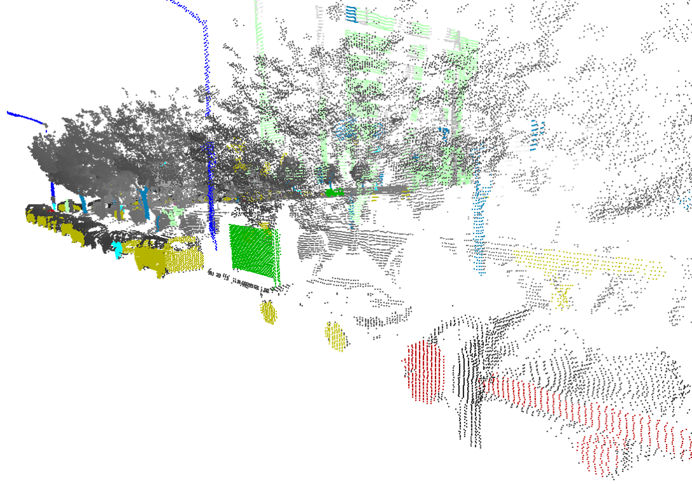
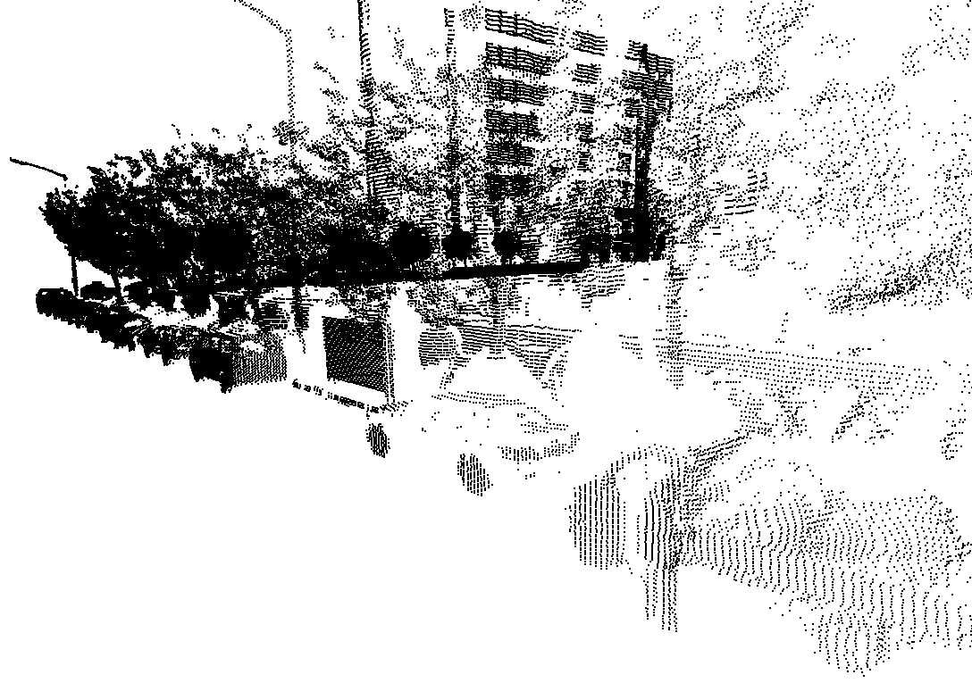
Result in Street Scene
Data Graph
Model Graph
Result in street scene
Car
Signpost
Truck
Building
Road lamp
Ad board
Notes:
As we can see, there are lots of trees & bushes, occluding some objects of interest.
Take a look at the car. Though much of its surface are not correctly sensed, we are still able to label it as “car salient” because we have such kind of previously generated model graph.

Slide 19
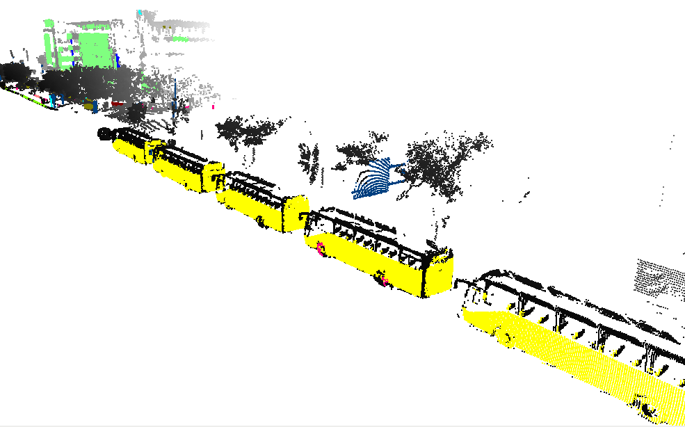
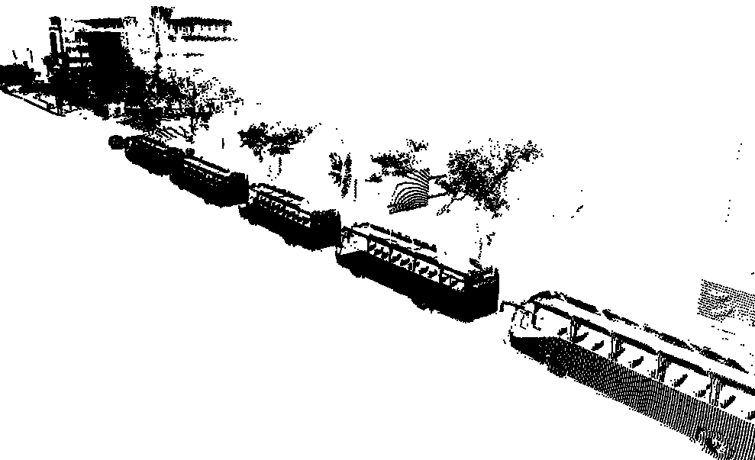
Result in Street Scene
Data Graph
Model Graph
Bus
Traffic sign
Building
Notes:
Another scene, the supporting pole of the traffic sign is occluded.
It is still correctly labeled because of missing-tolerance of graph matching

Slide 20
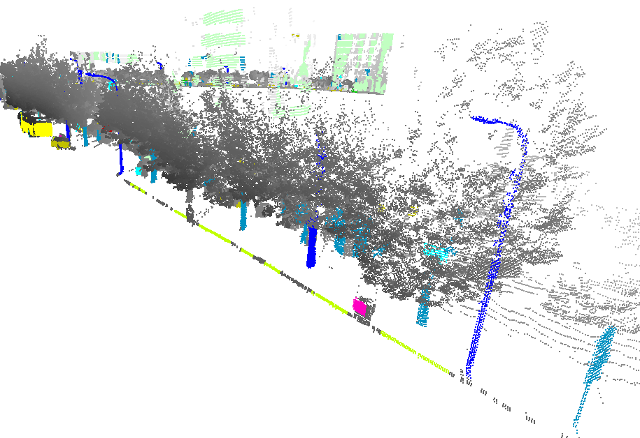
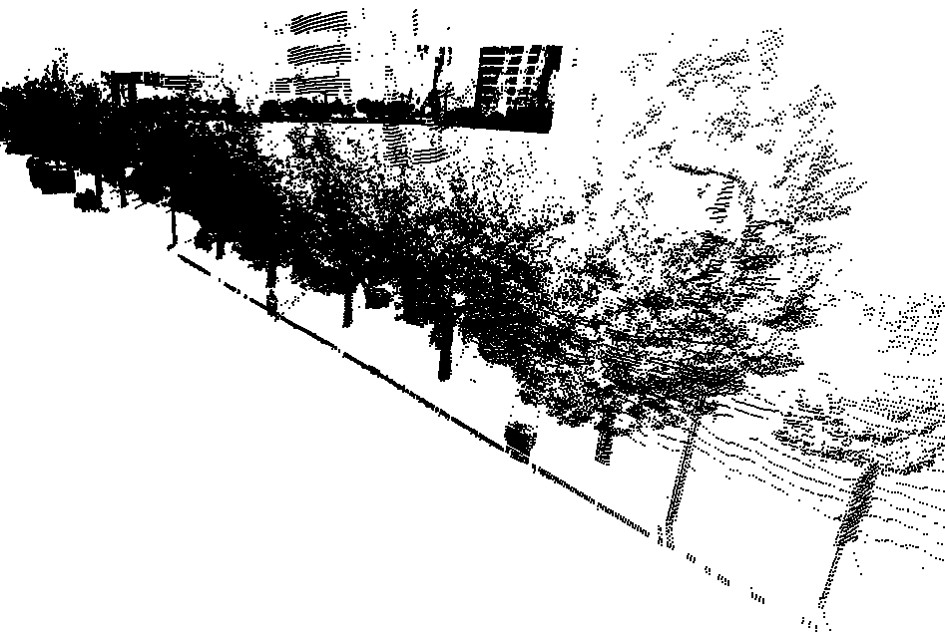
Some Errors
Car
Traffic sign
Bus
Signpost
Road lamp
Road belt
Trash box
Building
Notes:
Admittedly, there are errors in the result, mainly because of the trees & brushes.
Notice the two tree trunks are mis-labeled as objects of interest.

Slide 21
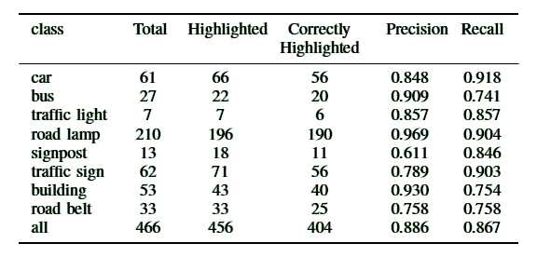
Statistical Result
*Highway scene only
Notes:
We also statistic the precision & recall rate in highway scene.
As you see, road lamp receive the best performance since its primary geometry are simple & clear;
While the results of signpost & road belt are not so good, since the data of them greatly suffers from occlusion.

Slide 22
Summary
Compute the object-based saliency of urban laser sensing data
Highlight the data of objects of interest
Help object detection in the subsequent procedures
In the future
On-line application
More comprehensive approach (include context information)

Slide 23
Thanks

